Slide 3
CHAPTER 17
The Cloud and Distributed Computing

Slide 4
Introduction
Cloud computing is about the on-demand availability of resources.
In this chapter, we will focus on how a software architect can use infrastructure services from the cloud to deliver the services that the architect is designing and developing.
Along the way, we will take a journey into some of the most important principles and techniques of distributed computing.
distributed computing means using multiple computers to work cooperatively together, thereby producing faster performance and a more robust system.
Distributed computing is a fundamental and essential for cloud-based systems.
The treatment we give here is a brief overview of the principles most relevant to architecture.

Slide 5
17.1 Cloud Basics
Public clouds are owned and provided by cloud service providers.
companies like AWS, Azure, or Google Cloud.
Private clouds are owned and operated by an organization for the use of members of that organization.
An organization might choose a private cloud because of concerns such as control, security, etc.
The hybrid cloud approach is a mixed model, in which some workloads are run in a private cloud and other workloads are run in a public cloud.
It might be used because some data are legally required to be subject to greater control and scrutiny.
For an architect designing software using cloud services, there is not much difference, from a technical perspective, between private clouds and public clouds.

Slide 6
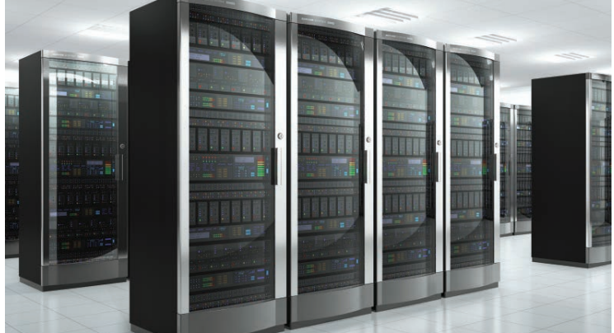
17.1 Cloud Basics
The data center consists of rows and rows of such racks.
Each rack consists of more than 25 computers (each with multiple CPUs).
Cloud data centers are one reason why energy efficiency has become a critical quality attribute in some applications.
Cloud regions are physical and logical groupings of data centers around the world.
Regions reduce latency by being closer to users and help with legal compliance (like GDPR) by keeping data in-country.
There are two main gateways into a cloud: a management gateway and a message gateway. Here we will focus on the management gateway.

Slide 7
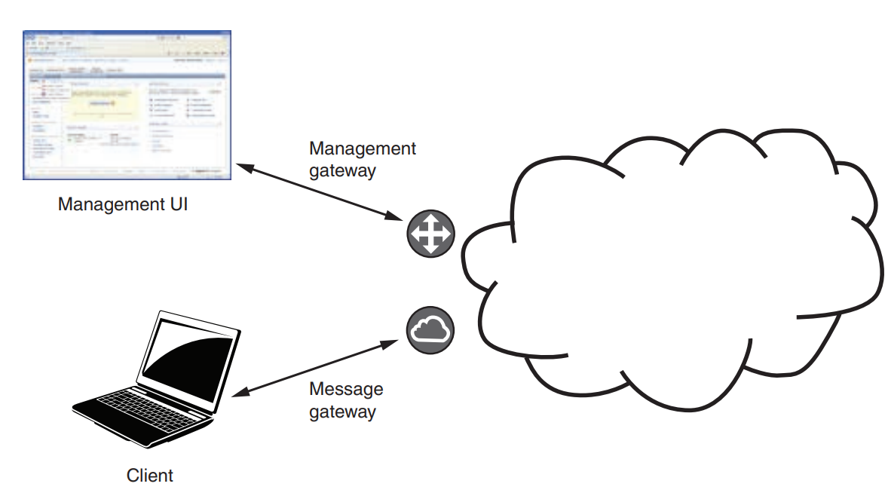
management gateway vs message gateway

Slide 8
17.1 Cloud Basics
Steps to have a VM allocated for you in the cloud:
You send a request with parameters like region and instance type (e.g., CPU and memory size).
The management gateway is responsible for many physical computers, and each has a hypervisor that manages the VMs on it.
The management gateway finds a hypervisor with enough free resources then asks that hypervisor to create an additional VM.
Once created, you receive its IP address. Cloud providers ensure resources are always available.
The management gateway performs other functions besides allocating new VMs.
collecting billing information about the VM.
providing the capability to monitor and destroy the VM.
The management gateway is accessed through its API.
Usually there is also a web interface (like AWS Console), but it's mostly useful for simple tasks.

Slide 9
17.2 Failure in the Cloud
When a data center contains tens of thousands of physical computers, it is almost a certainty that one or more will fail every day.
Amazon reports that in a data center with around 64,000 computers, each with two spinning disk drives, approximately 5 computers and 17 disks will fail every day.
In addition to computer and disk failures, network switches can fail; the data center can overheat, causing all the computers to fail.
Although your cloud provider will have relatively few total outages, the physical computer on which your specific VM is running may fail.
We’ll discuss two concepts especially relevant to failure in the cloud: timeouts and long tail latency.

Slide 10
Timeouts
Recall that timeout is a tactic for availability. In a distributed system, timeouts are used to detect failure. There are several consequences of using timeouts:
Timeouts can’t distinguish between a failed computer or broken network connection and a slow reply to a message that exceeds the timeout period. This will cause you to label some slow responses as failures.
A timeout will not tell you where the failure or slowness occurs.
Many times, a request to a service triggers that service to make requests to other services, which make more requests. Even if each of the responses in this chain has a latency that is close to (but slower than) the expected average response time, the overall latency may falsely suggest a failure.
There is usually a cost for a recovery action. Jumping to a conclusion that there was a failure, when there was actually just a temporary delay, may add a recovery cost when it isn’t necessary.

Slide 11
Timeouts
Distributed system designers generally parameterize the timeout detection mechanism so that it can be tuned for a system or infrastructure.
One parameter is the timeout interval.
Most systems do not trigger failure recovery after a single missed response. The number of missed responses before failure recovery is a second parameter for the timeout mechanism.
Timeout settings differ by environment:
In single data center systems, you can use shorter timeouts since delays are rare and failures are often real.
In wider, less reliable networks you should use more relaxed timeout settings to avoid reacting to normal delays as if they were failures.

Slide 12
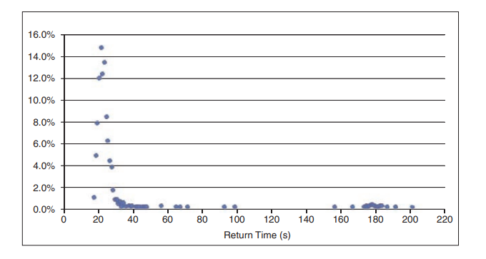
Long Tail Latency
Long-tail latency refers to the impact of a small percentage of requests that take significantly longer to process than the majority of requests.
This figure shows a histogram of the latency of 1,000 “launch instance” requests to Amazon Web Services.
You must be careful which statistic you use. In this case, the histogram peaks at a latency of 22 seconds, the average latency over all the measurements is 28 seconds, and the median latency is 23 seconds.
Although the mean latency for each service-to-service request to a cloud-based service may be within tolerable limits, a reasonable number of these requests can have much greater latency.
Notice how right side of the histogram looks like a long tail on the ground.

Slide 13
17.3 Multiple Instances for Performance and Availability
If a service hosted in a cloud receives more requests than it can process within the required latency, the service becomes overloaded.
Sometimes, you can fix this problem by running the service on a different virtual machine that has more resources. This is called vertical scaling.
There are limits to what can be achieved with vertical scaling. In particular, there may not be a large enough VM instance type to support the workload.
Horizontal scaling involves having multiple copies of the same service and using a load balancer to distribute requests among them—equivalent to the maintain multiple copies of computations tactic and the load balancer pattern.

Slide 14
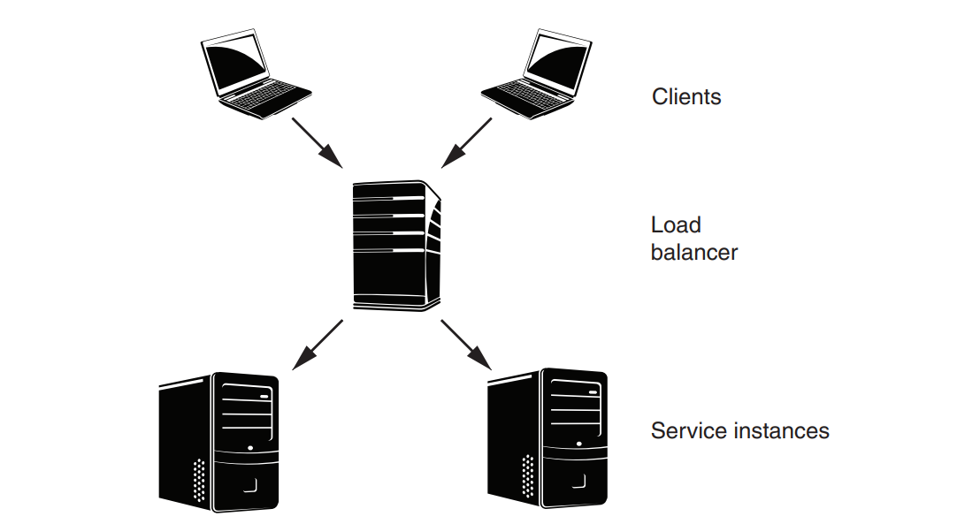
Load Balancers
Suppose the load balancer sends the first request to instance 1, the second request to instance 2, the third request back to instance 1, and so forth.
The algorithm we provided is called round-robin.
round-robin balances the load uniformly if every request consumes roughly the same resources.
From a client’s perspective, the service’s IP address is actually the address of the load balancer.
Load balancers may get overloaded. In this case, the solution is to balance the load of the load balancer, sometimes referred to as global load balancing. That is, a message goes through a hierarchy of load balancers before arriving at the service instance.
Load balancers increase the amount of work that can be handled. We'll see how load balancers also serve to increase the availability of services.

Slide 15
Load Balancers
While requests go through the load balancer, responses go directly back to the clients.
As a consequence, the load balancer has no information about whether a message was processed by a service instance, or how long it took to process a message.
Hence the load balancer would not know whether any service instance was alive or if it had failed.
Health checks are a mechanism that allow the load balancer to determine whether an instance is performing properly.
The load balancer will periodically check the health of the instances assigned to it.
If an instance fails to respond to a health check, it is marked as unhealthy and no further messages are sent to it.
Health checks can consist of pings from the load balancer to the instance, opening a TCP connection to the instance or even sending a message for processing.
A load balancer with health checking improves availability by hiding the failure of a service instance from clients.

Slide 16
Autoscaling
In a traditional data center, organizations must buy enough hardware for the peak workload, which leads to wasted capacity when usage is low. In contrast, cloud computing allows you to dynamically adjust resources based on your needs—this is the concept of elasticity.
Autoscaling is an infrastructure service that automatically adds or removes VM or container instances based on current demand.
It usually works with load balancers to manage traffic to these instances.
Autoscaling containers is slightly different from autoscaling VMs.
Autoscaling containers is slightly different from autoscaling VMs.
Autoscaling VMs:
When the existing service instances can’t handle all the incoming client requests, autoscaling creates another instance using the same VM image and registers it with the load balancer.

Slide 17
Autoscaling
if the client request rate decreases, an instance can be removed from the load balancer pool, halted, and deallocated.
Autoscalers don’t react to short-term spikes in resource usage. Instead, they look at averages over several minutes because:
Resource usage can spike briefly but doesn't always mean more capacity is needed
allocating and starting a new VM takes a relatively long time, on the order of minutes.
Autoscaling Containers:
Because containers are executing on runtime engines that are hosted on VMs, scaling containers involves two different types of decisions.
Should you add a new container (or Pod) based on workload?
If yes then can it be run on an existing VM, or do you need to create a new VM for it?
The software that controls the scaling of containers is independent of the software that controls the scaling of VMs. This allows the scaling of containers to be portable across different cloud providers.

Slide 18
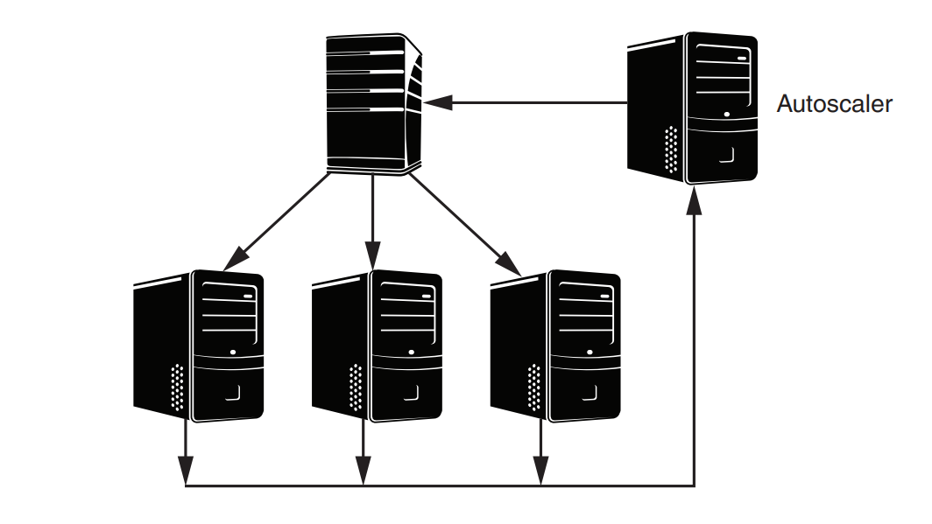
This figure shows a new component, the autoscaler, that monitors and autoscales the utilization of the server instances.

